Slide 1

by VIF Tech
Adeniyi Ajobiewe
Nkemdi Anyiam
Insoo Chung
Nangga Nan
Ryan Zesch
Notes:
Howdy, we are VIF tech, we worked on the new website for visualization industry fair or VIF

Slide 2
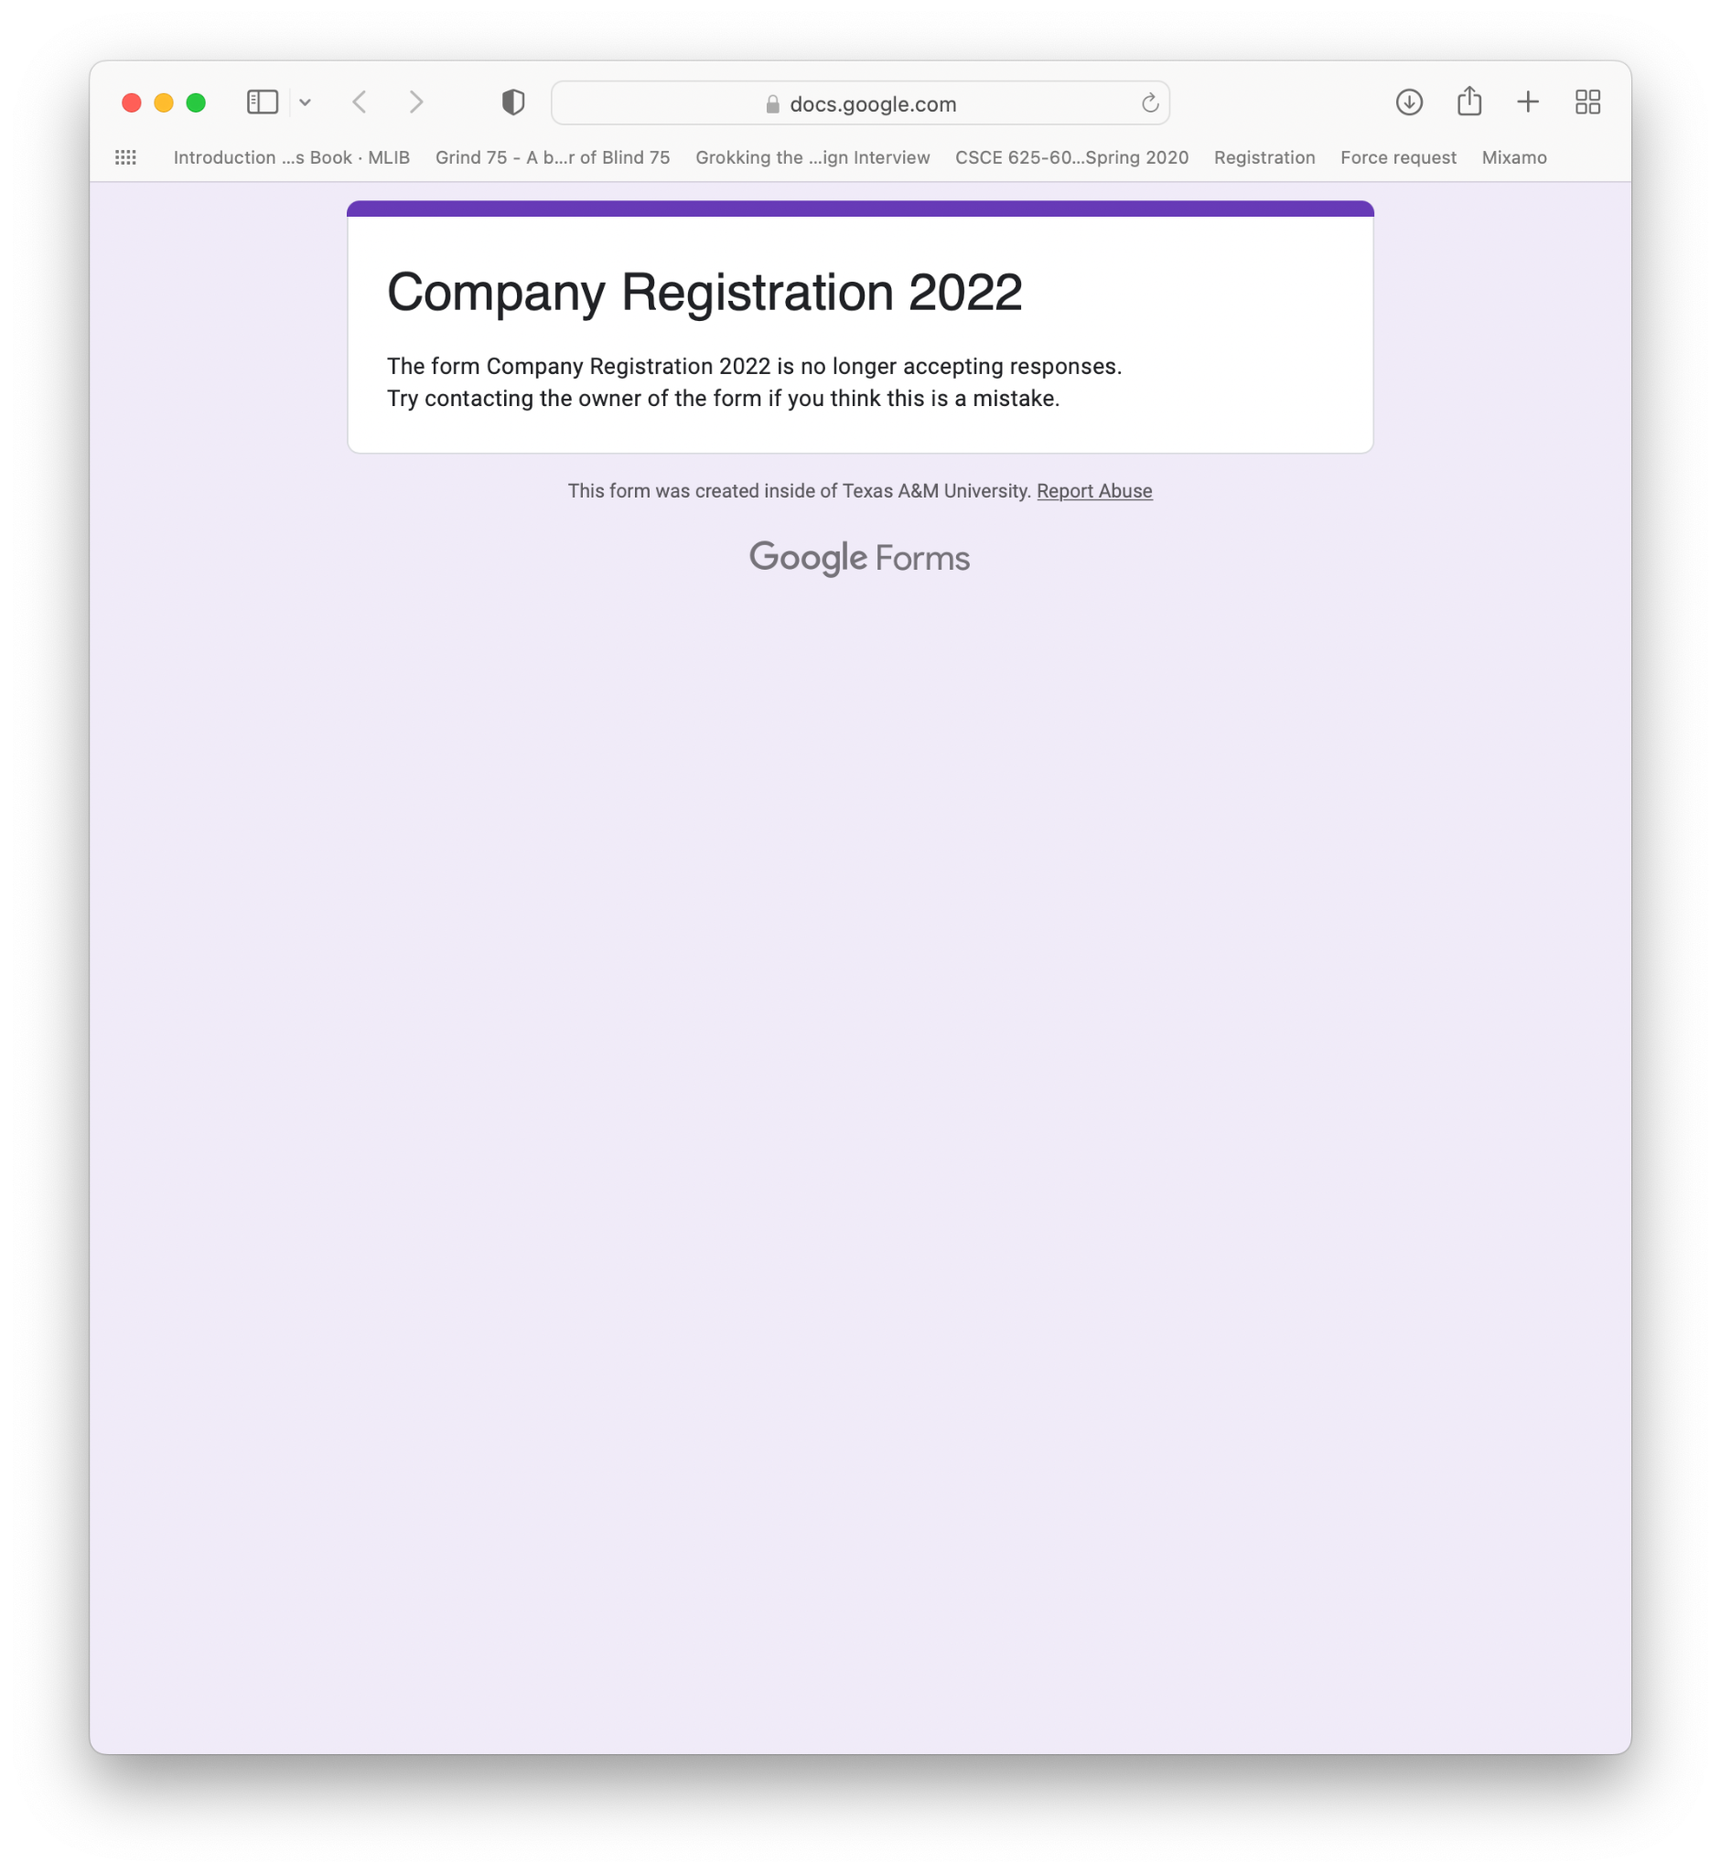
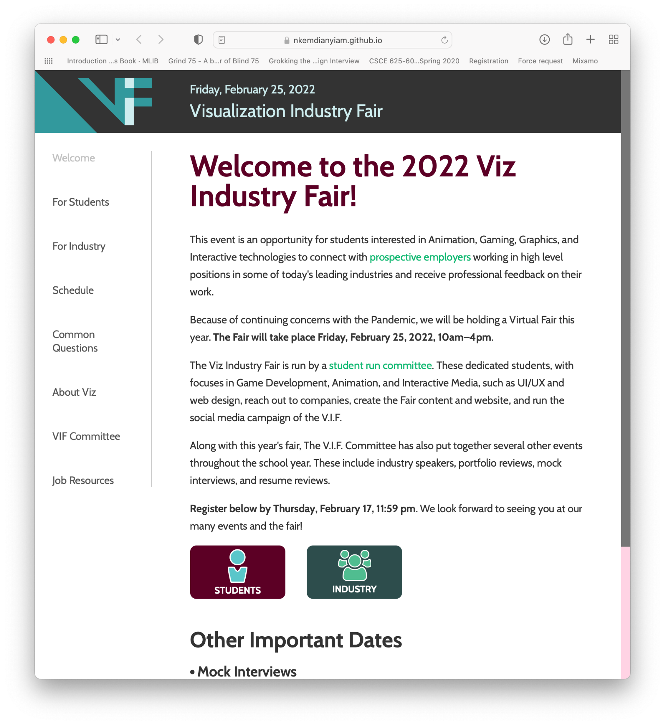
Project
Website for Visualization Industry Fair (VIF)
To connect students with industry leaders for career opportunities
Clients: VIF Committee (the event organizers)
Previous year’s website
i. No backend fn., only manual updates
ii. Low visibility for non-admin users iii. Purely static with many external links
New website! i. Easy data management ii. Self contained functionality
Notes:
Our project was building a new website for vif. And as the name suggests, the purpose of this website is to connect the students with industry professionals for career opportunities.
Our clients are VIF committee: they are staff, faculty, and students from visualization department.
Previous year, they had a static website that relied mostly on google forms.
The website didn’t have a backend, and relied on manual updates.
And non-admin users couldn’t browse any data
So all communications had to go through the admin, which caused communication bottleneck.
So our clients wanted a website that
Provided an easy way to access, manage and generate data.
And our clients wanted the website to be fully functional /on its own/ and not utilizing outside apps.

Slide 3
Major stories
Support user registration of different parties
Students, volunteers (faculty members), company representatives, and administrators.
Notes:
For the project there were 3 main stories that needed to be implemented.
First, we had to support registration for 4 different types of users and we had to provide a way to confirm the user identity.

Slide 4
Story req. - user access confirmation
Company rep.
👩‍💼
Student
🤓
Volunteer🧑‍🏫
Admin
🔑
*@activision.com *@pixar.com
or exact match with DB entries
*@tamu.edu *@exchange.tamu.edu
*@arch.tamu.edu
exact match with DB entries
exact match with DB entries
Successful registration! – but failure otherwise
Notes:
The user types are company representatives, students, volunteers from the faculty members and administrators.
Because each user type is granted different privileges, it is important that we confirm the identity of each user and assign them to a relevant group.
In the previous fairs, admins used the user emails to confirm their identity.
For example company reps were identified with their company emails, students with their texas a&M emails.
So naturally our clients wanted an automated email based confirmation system

Slide 5
Major stories
Support user registration of different parties
Students, volunteers (faculty members), company representatives, and administrators.
Users can sign up to fair events and view information
Event time and registration time can be managed
Registered users can view timesheet containing event activities (scheduled meetings, industry booths)
Students can view attending {users, companies}’s information
Notes:
Also, our clients wanted to have the notion of events.
For example, if they wanted to hold a mock interview event on February and industry fair on March, they wanted to group all relevant activities by these events.

Slide 6
Story req. - event registration
Company rep.
👩‍💼
View event information
Users/companies attending
Event timesheet (meetings, industry booths)
VIF event
🎪
Volunteer🧑‍🏫
Provide availabilities to meet w/ students Open industry booth (rep)
Student
🤓
Register – within registration timespan
Notes:
The developed requirements were:
First, all users should be able to register to events, within registration timespan.
And volunteers and representatives should be able to provide availabilities.
In case of company reps, they can open industry booths.
Finally, registered users should be able to view event data: information about users/companies attending, and there should be a big event timesheet that allows user to see all the activities. The event information should tell the users the status of the event and what they can do.

Slide 7
Major stories
Support user registration of different parties
Students, volunteers (faculty members), company representatives, and administrators.
Users can sign up to fair events and view information
Event time and registration time can be managed
Registered users can view timesheet containing event activities (scheduled meetings, industry booths)
Students can view attending {users, companies}’s information
Administrators should be able to view user availability and match students to {volunteers, company representatives}
Users can upload/edit/delete their availabilities.
Notes:
And the last core requirement is that admins should be able to view user availabilities and and connect them through meetings

Slide 8
Story req. - students matching
VIF event 🎪
Admin
👀
Company rep.
👩‍💼 Hiring for: 🎨🎭🎬
Available on…
i. 9:00-9:20 AM
ii. 9:30-9:50 AM
iii. 1:00-1:20 PM
Create matches
Mock interview
View user information
User interests
(students) portfolio, resume, email
Student
🤓 Interests: 🎭🎬🎤
Volunteer 🧑‍🏫 Focuses: 🎬🎤🎧
Available on…
i. 1:00-1:20 PM ii. 1:30-1:50 PM iii. 2:00-2:20 PM
Portfolio review
Notes:
For example, when an admin sees a student whose interests align well with a company representative the admin can set up a mock interview or a portfolio review between them. Admins should be able to do the same between the students and volunteers. And finally all attending users should be able to view other users’ data.

Slide 9
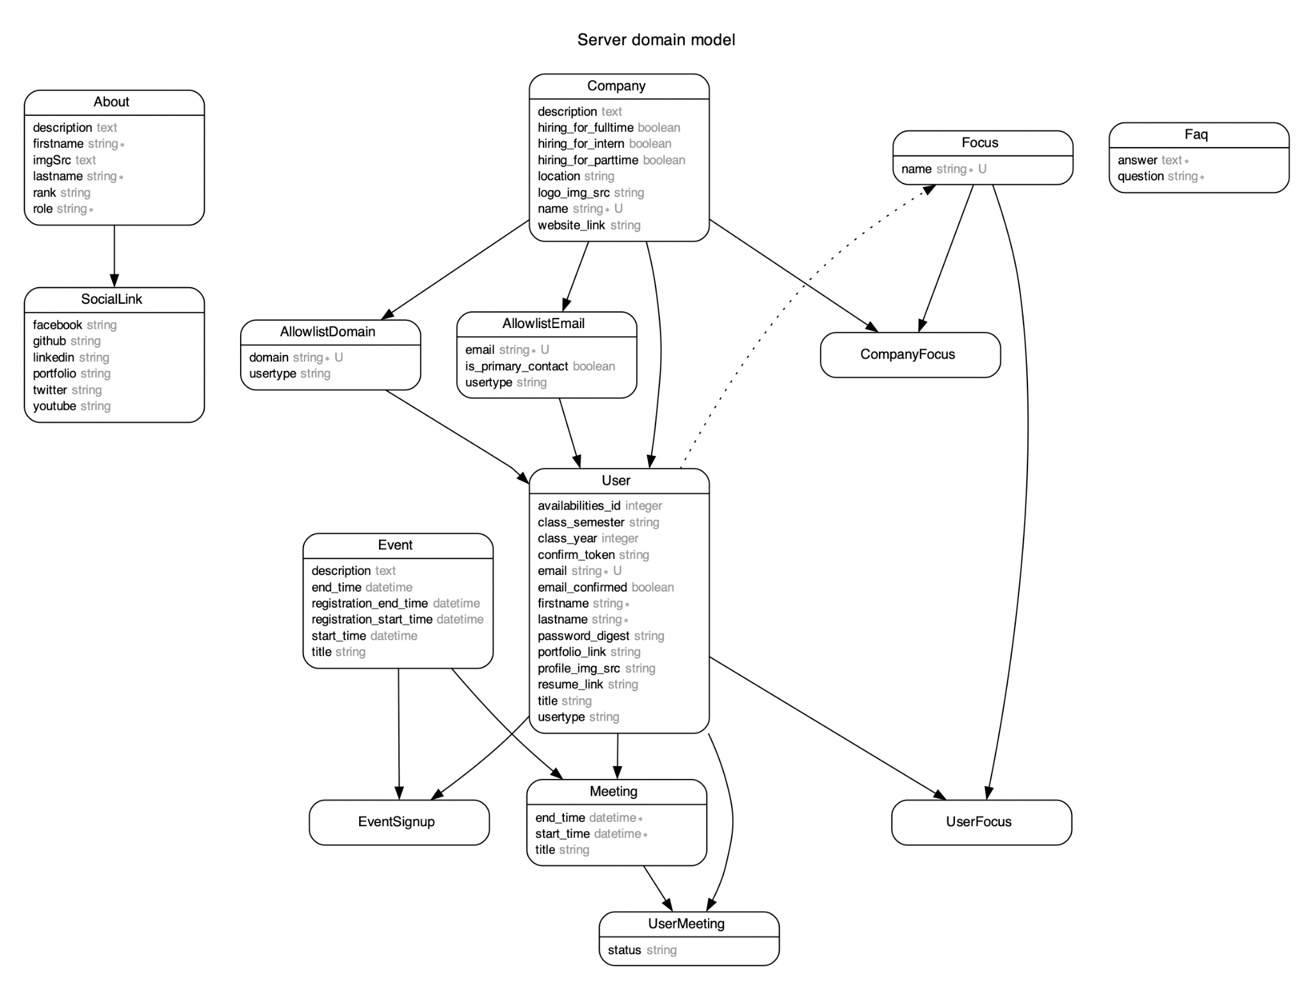
ERD
Notes:
This is the entity relationship diagram of the final product. And it shows how the entity relationships designed to support our requirements.

Slide 10
ERD
Notes:
The entities here are relevant to users and registrations.
We have the user model that can represent different types of users.
For the email based registration confirmation, we utilized entities called allowlistdomain and allowemail. This ensures that only the users who are relevant can sign up and correct previlleges are granted. For the company users, we have a company model that holds onto relevant users. And there’s also a focus model that can be associated with with a user or a company. Admins can look at them to make informed decisions when connecting the users.

Slide 11
ERD
Notes:
And there are entities called events. Admins can create events, assign them the start and end times, and registration time. And there are meetings that can be associated with events. Meetings can be created for mock interviews, portfolio reviews, industry booths, or general availability. The meeting attendees are tracked with usermeeting entities.

Slide 12
ERD
Notes:
And finally we have about and FAQ models that populate website contents. These can be created, updated, and deleted by the admins.

Slide 13
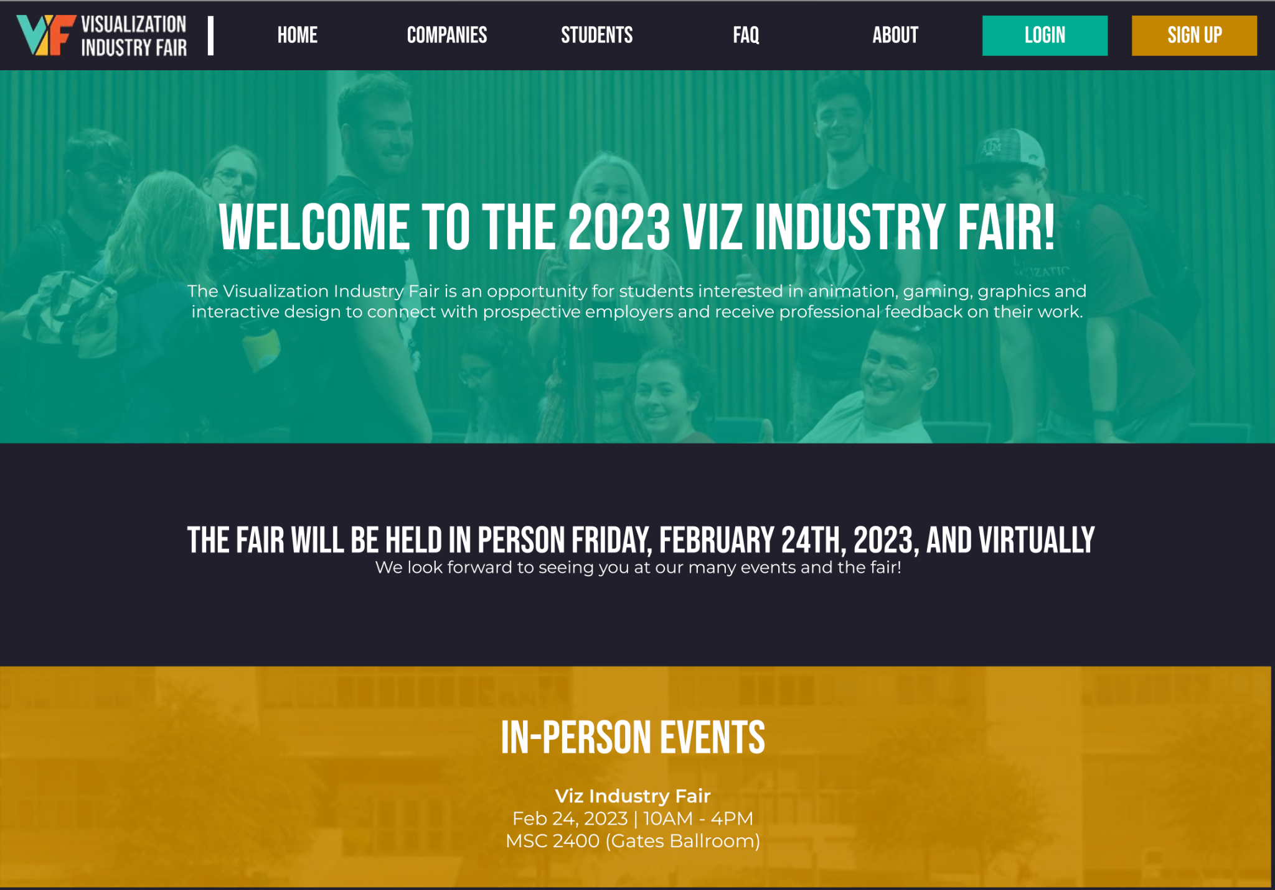
UI/UX requirements
Mockups by VIF Committee - technical communication on our side
React + Rails combo to meet high UI/UX standards
Notes:
Another thing to note is that the admins had a high standard for the website design. The shown sample is a mock up by our clients. We communicated with them and we realized that in order to meet their high standards, React + rails combo would be better than full stack rails.

Slide 14
Approach - XP & TDD based
Challenge: incremental requirements
Extreme programming
Fast releases, unit testing all code, YAGNI
{11 meetings, 5 demos} w/ clients
TDD-centric approach (w/ a hint of BDD)
RSpec unit tests first
Cucumber behavioral after requirement finalized
Notes:
So one challenge was the requirements took over the iterations - meaning that we had to make a lot of modifications.
So our approach was more of an extreme programming approach. We followed the principle of fast release, unit testing all of the code and, and the you are not going to need it - meaning that we didn’t implement things that we didn’t need at the moment.
We met with our clients multiple times over 11 meetings and 5 demos.
And our approach was more of a TDD centric one.
We developed unit tests first then once the requirements finalized, we worked on the cucumber tests.

Slide 15
Approach - XP & TDD based
Benefits
High percentage of test coverage at all times
Tests to reference other people’s work
No complex errors - all caught on unit test level
Pair programming helped with learning curve
Problems
Assumptions by unit tests falsified as requirements were revised
Notes:
The benefit of our approach was that we always had most of our code covered by the tests
And tests helped us communicate because we could reference them.
We didn’t run into complex errors because things were thoroughly tested
And pair programming helped with initial learning curve.
The problems we mostly ran into was that our unit tests made assumptions when the requirements weren’t finlaized, and many times we had to go back and fix the functionality and the tests.

Slide 16
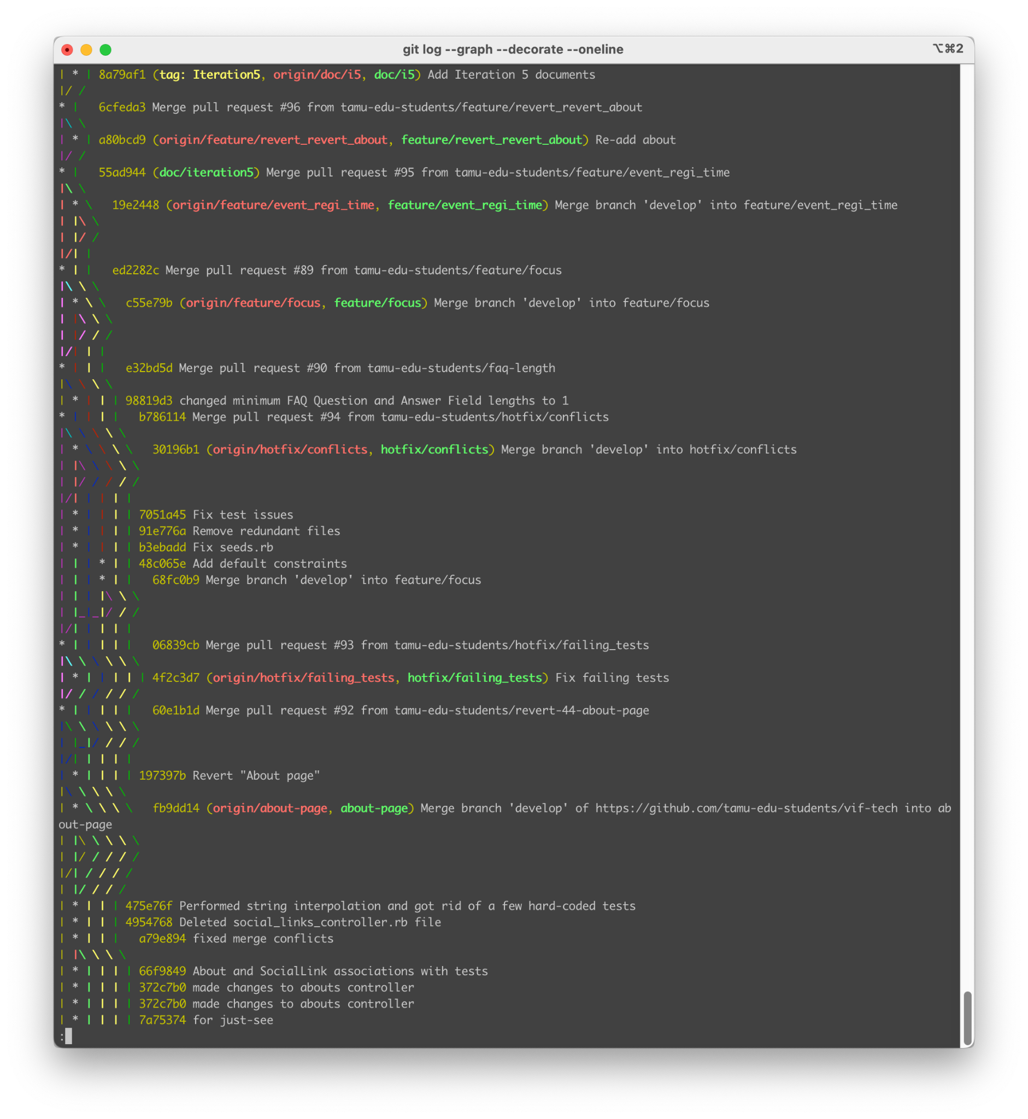
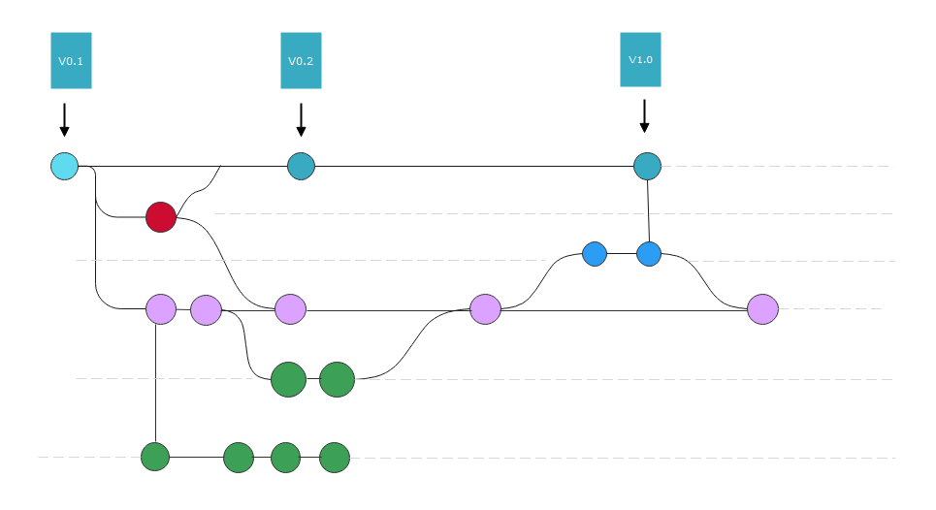
Approach - Version management
Adopted Git workflow
1* main, 1* develop branches
Only reviewed PRs get merged
Multiple feature/hotfix branches
Notes:
As for version management, we adopted git workflow, mostly working with a main and a develop branch.
Each feature was worked on a separate PR, and only the tested and reviewed PRs made it to the develop and main branch

Slide 17
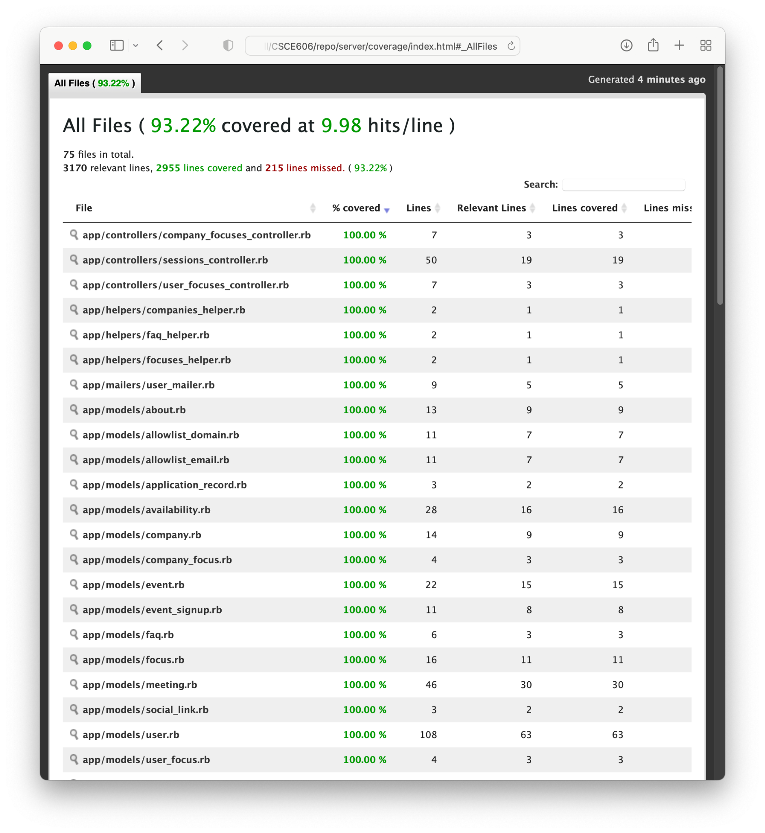
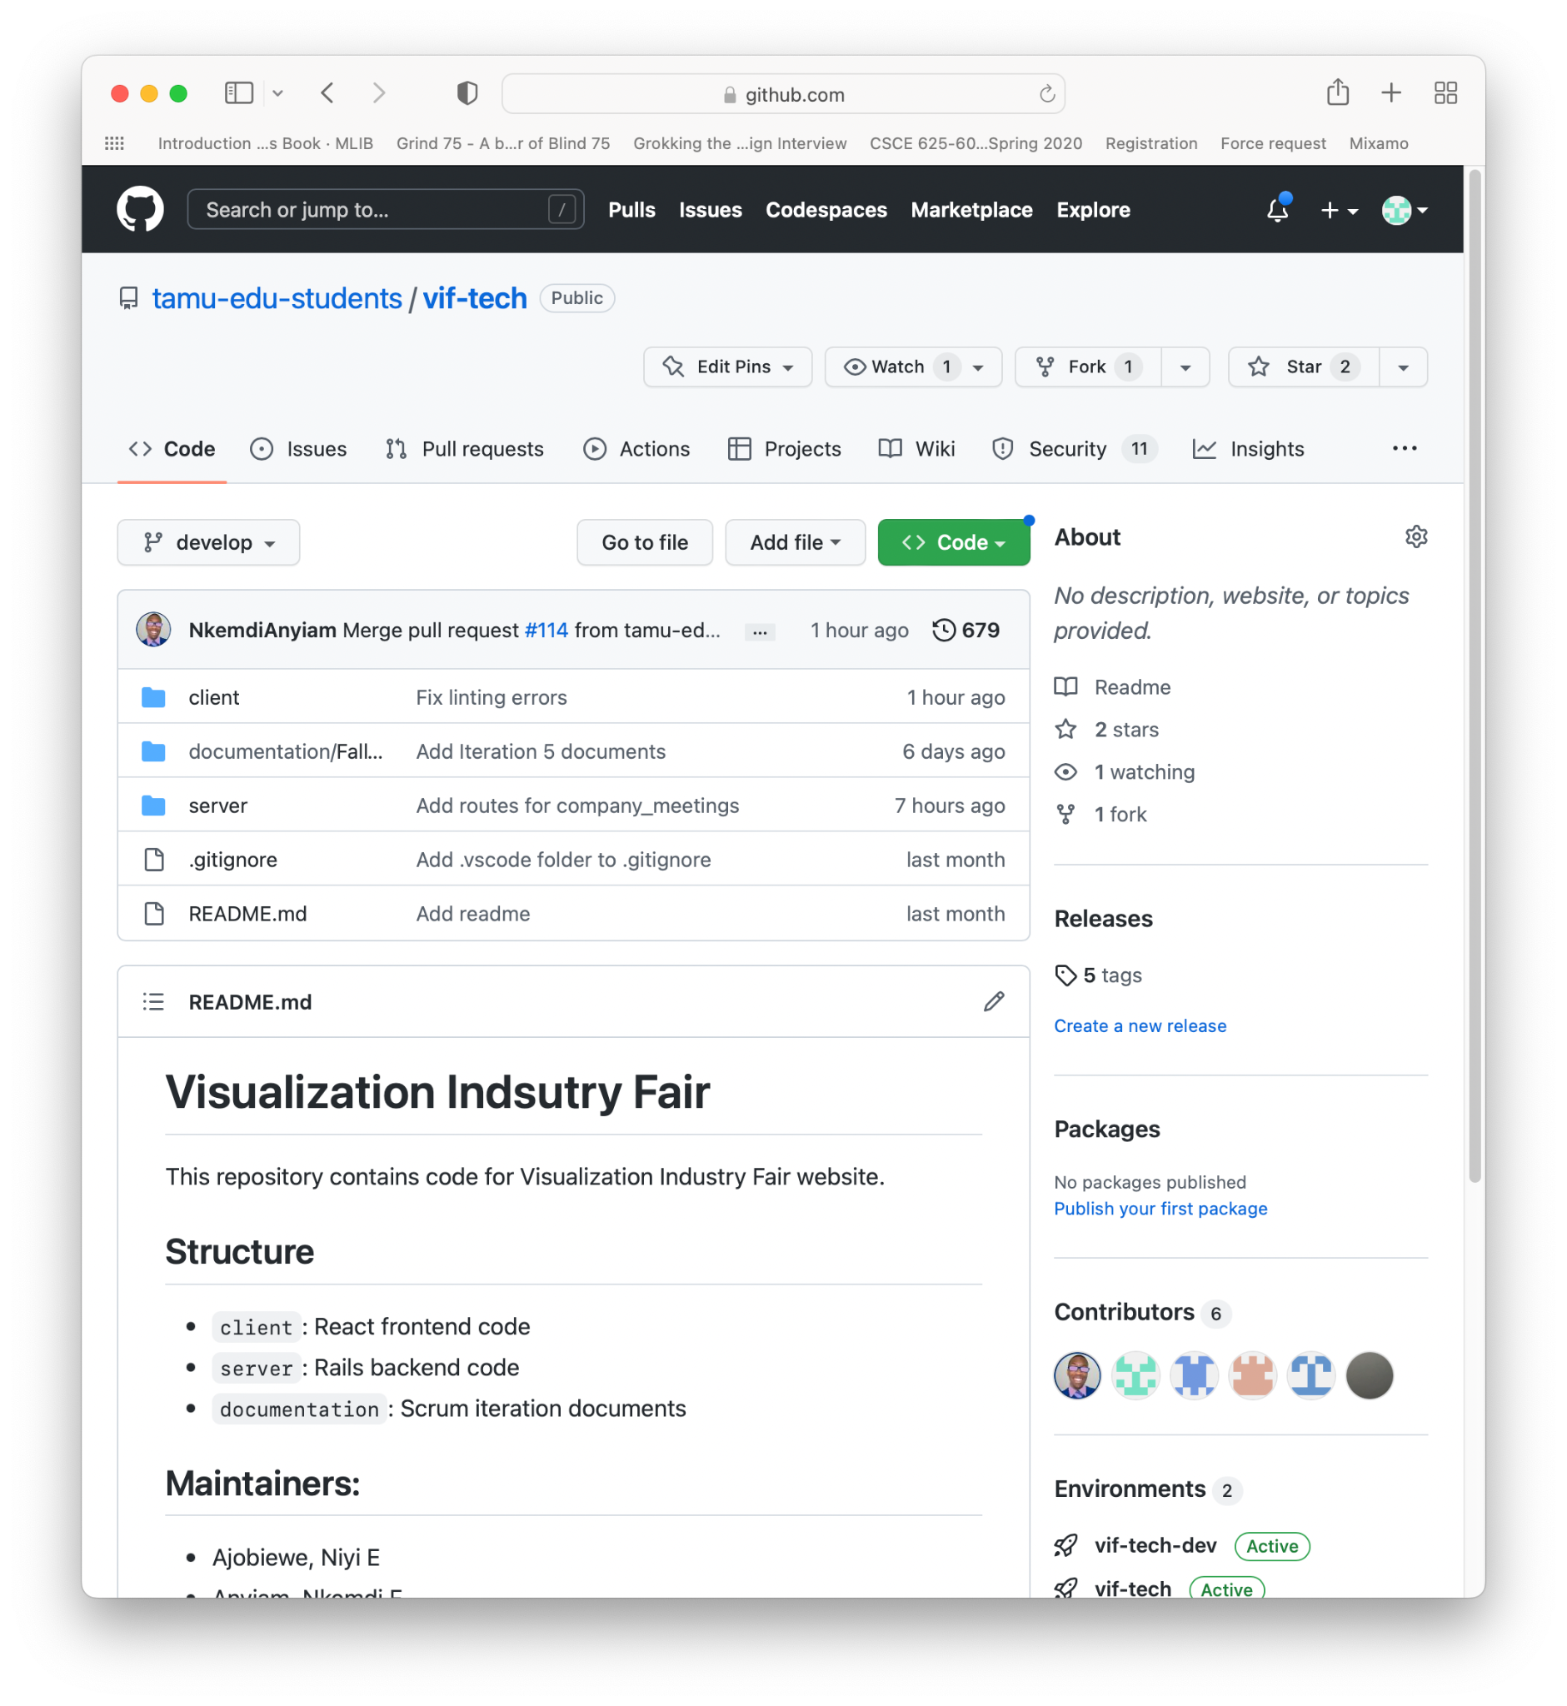
Statistics - tests, Github
Tests
RSpec: 109 examples
Cucumber: 133 scenarios / 1230 steps
Github
114 PRs (≈ # of branches)
679 Commits
Notes:
And this is the final number of tests that we created:
~~~
And we had 114 PRs and roughly the same number of branches
Totalling at 579 commits.

Slide 18
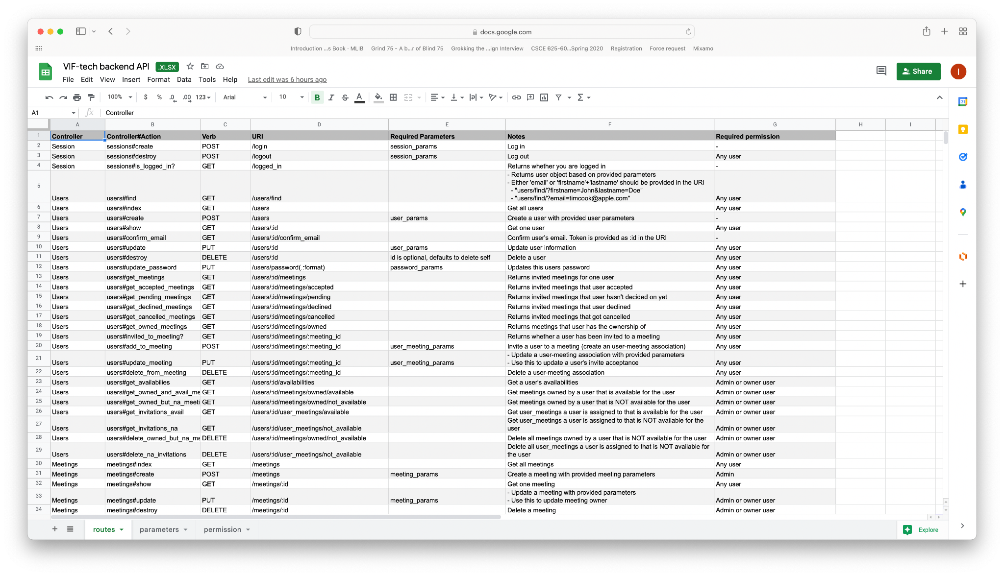
Stats - routes
113 routes – all documented
Notes:
We have 113 backend API routes, all of them documented.

Slide 19
Lessons
Communication is hard
Document! PRs, slack communication, route document, etc.
Communication > assumptions
30% of the issues
Problem will arise where tests are half-baked
70% of all issue we ran into
Notes:
The major lessons were:
That communication’s hard. The only way to make it any easier is to document things through PRs, slack, code docs.
Also, whenever we assumed something we had to later fix it. So communication’s important
And whenever we skimmed on the tests, we ran into an error.
Thank you.

